Slide 1
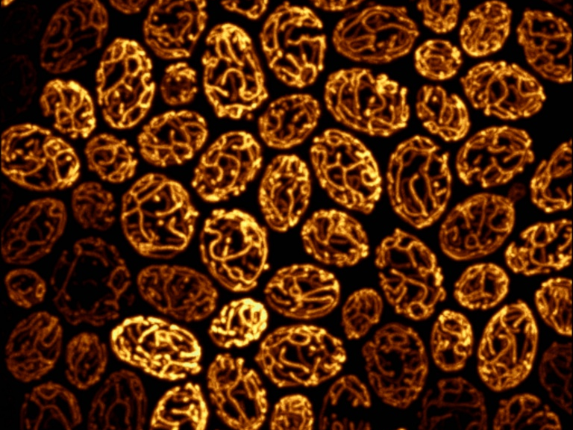
Principles and Practices of Light Microscopy Lecture 7: Light sources and Cameras
Kurt Thorn, NIC
Image: Susanne Rafelski

Slide 2
Light Sources
Arc Lamps
Hg and Xe
Metal Halide
LEDs
Plasma
Lasers
Generally only for collimated illumination (Confocal, TIRF)

Slide 3
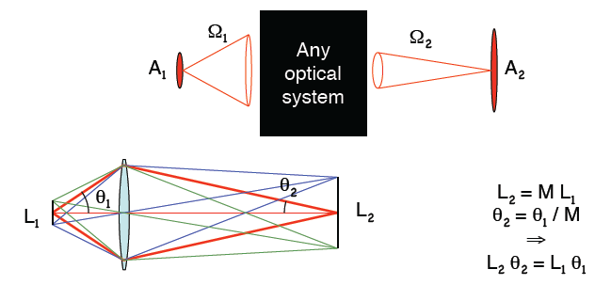
Light Sources
Constraint: area × solid angle is invariant

Slide 4
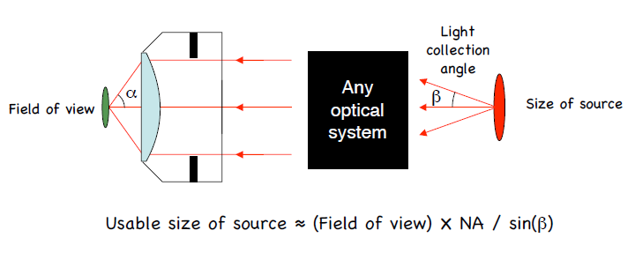
Brightness
(area × solid angle) at sample ≤ (area × solid angle) at source
No optical system can increase it

Slide 5
Source and sample size should be similar
Widefield imaging
Extended sources: LEDs, arc lamps, etc.
Scanning systems
Laser sources

Slide 6
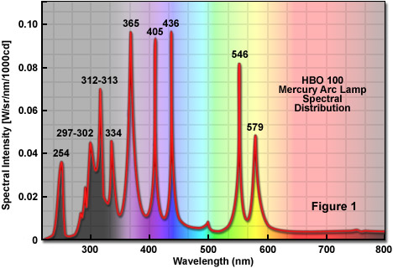
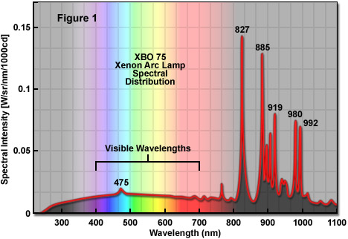
Arc Lamp Spectra
Hg: Brighter if your excitation spectrum matches one of the lines
Xe: More stable, longer lifetime, flat emission in visible is sometimes beneficial

Slide 7
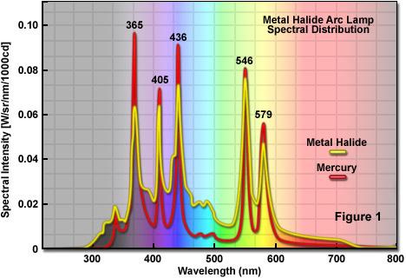
Metal Halide Arc Lamp
Exfo, Intensilight, etc.

Slide 8
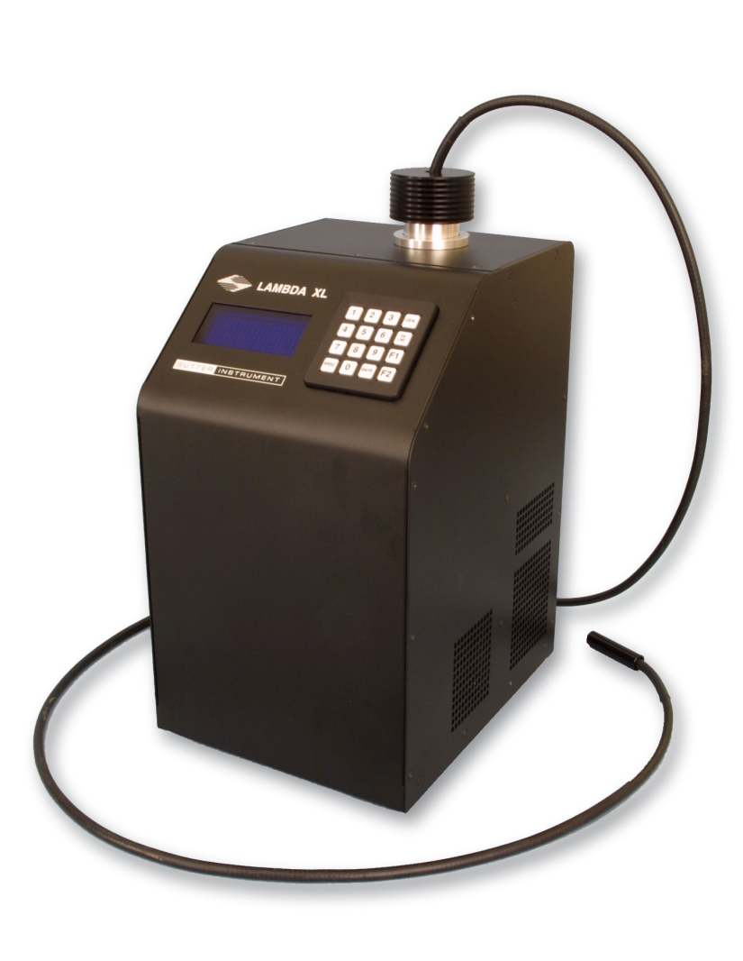
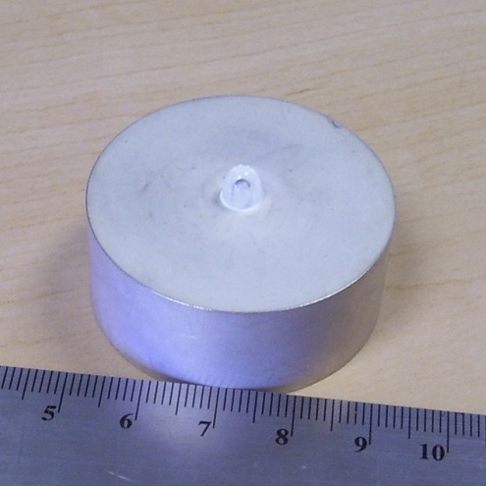
High efficiency plasma lamps
Essentially an arc lamp without electrodes – uses microwave waveguide to create a plasma in a quartz bulb
Broadband visible emission
Very long (>10,000 hr) lifetime
Commercialized by Sutter as XL lamp

Slide 9
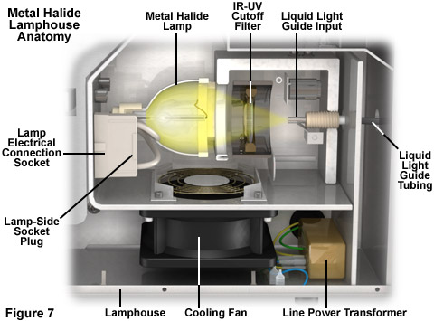
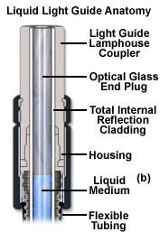
Liquid light guide coupling

Slide 10
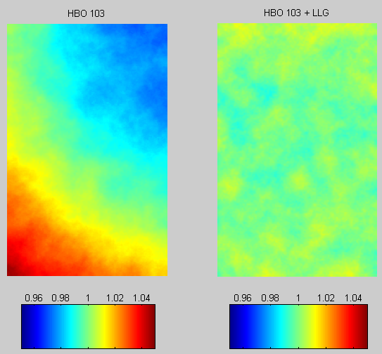
Benefit of Liquid Light Guide
Improved illumination uniformity

Slide 11
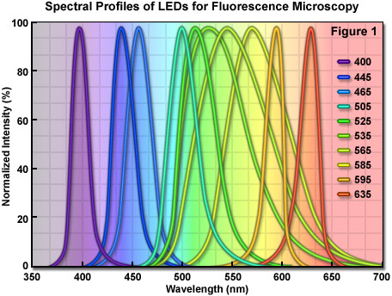
LEDs
Good in the blue / red
Not so good in the green / yellow
Long lifetime
Fast switching

Slide 12
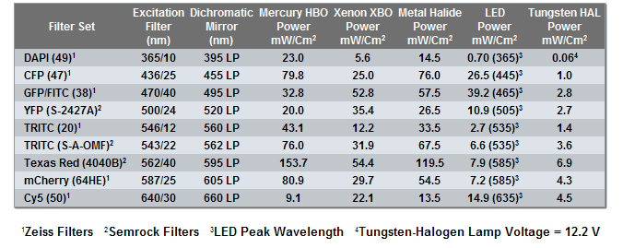
Relative lamp power
Summary: Metal Halide best; LEDs still not quite bright enough.

Slide 13
Lasers
Highly collimated, small source size
Many wavelengths and technologies
Gas lasers (chiefly Ar-ion)
Solid state (Nd:YAG, Ti:Sapphire, etc.)
Diode
Can frequency double, triple, quadruple
1064 nm Nd:YAG → 532 nm

Slide 14
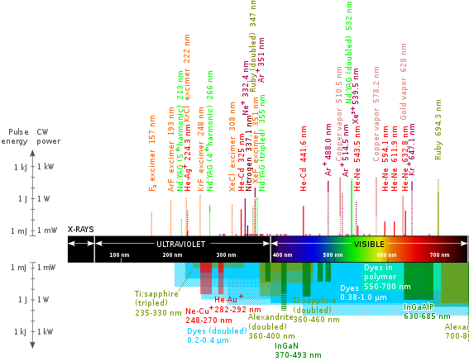

Slide 15
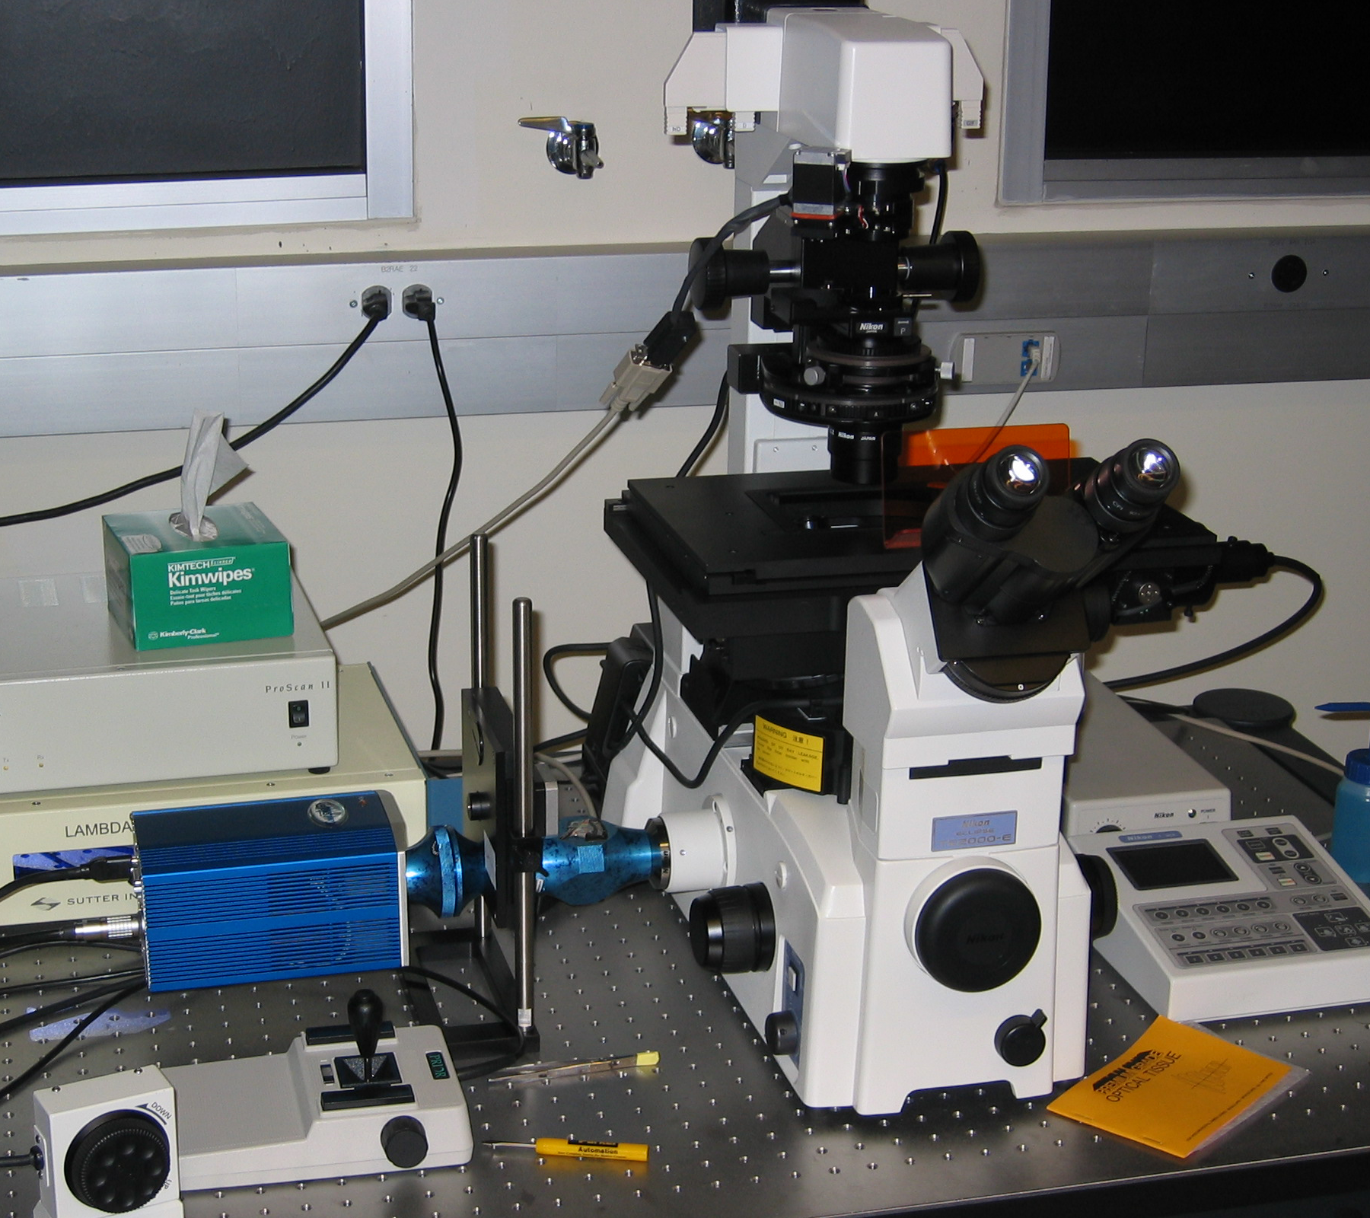

Slide 16
Detectors
Must
Convert light into an electrical signal
Ideally linear, low noise, accurate
Imaging detectors (cameras)
CCD : high QE, low noise, slow
CMOS : higher noise, fast
Non-imaging (single point, for scanning confocals)
Photomultiplier tubes: fast, moderate QE, low noise

Slide 17
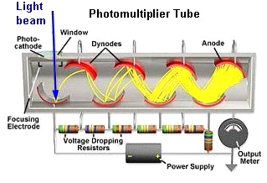
Detectors - PMTs
Must be fast – confocal beam spends only a few μs on each pixel
Photomultiplier tubes
Pulse width for single photon ~ 10-100ns
Very linear
Very high gain
~ 0 read noise

Slide 18
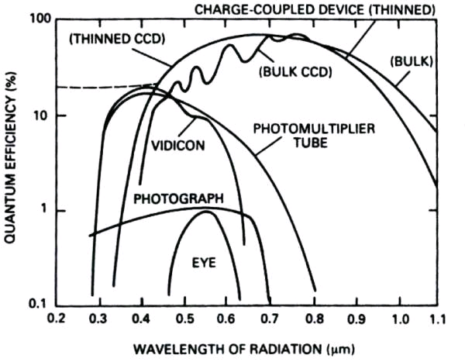
Detectors - PMTs

Slide 19
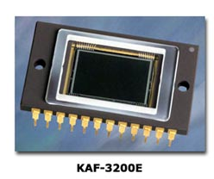
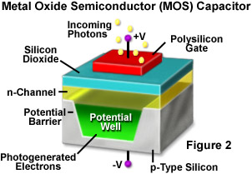
CCD architecture
…
…

Slide 20
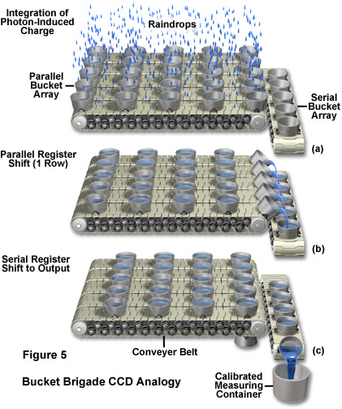
CCD readout “bucket-brigade” analogy

Slide 21
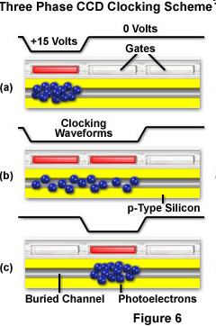
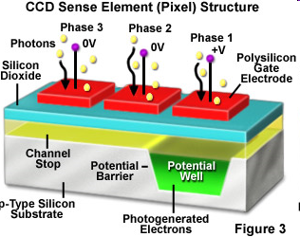
A little more realistic….
Each pixel is subdivided into three phases

Slide 22
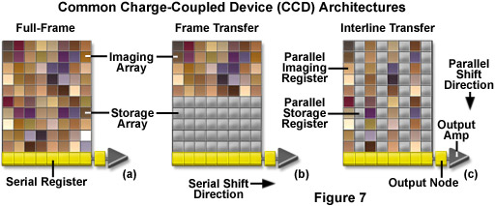
CCD Architectures
Rare
Mostly EMCCDs
Common
Full frame CCDs cannot acquire while being read out;
They also require a mechanical shutter to prevent smearing during readout.

Slide 23
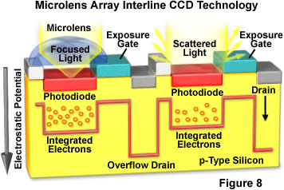
Interline CCDs and microlenses
Interline storage registers take up half the light gathering area on the CCD
Solution: use microlenses to focus light onto the light-gathering areas

Slide 24
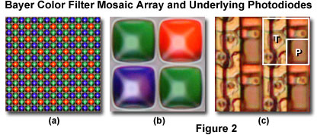
Why don’t we use color CCDs?
Four monochrome pixels are required to measure one color pixel
Your 5MP digital camera really acquires a 1.25 MP red and blue image and a 2.5 MP green image and uses image processing to reconstruct the true color image at 5 MP

Slide 25
Vital Statistics for CCDs
Pixel size and number
Quantum efficiency: the fraction of photons hitting the CCD that are converted to electrons
Full well depth: total number of electrons that can be recorded per pixel
Read noise
Dark current (negligible for most biological applications)
Readout time

Slide 26
Magnification and CCDs
1392
6.45 μm on a side
…
Chip is 8.98 x 6.71 mm on a side
1040
…
…
…
Typical magnification from sample to camera is roughly objective magnification

Slide 27
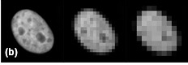
Resolution and magnification
More pixels / resolution element
Where is optimum?

Slide 28
Nyquist-Shannon Sampling
How many CCD pixels are needed to accurately reproduce the smallest object that can be resolved by the scope?
Nyquist-Shannon Sampling theorem: Must have at least two pixels per resolvable element
2.5 – 3 is preferable

Slide 29
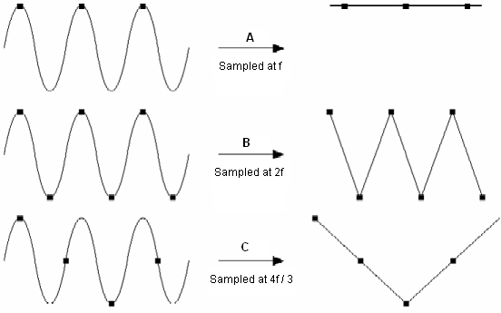
Nyquist-Shannon Sampling

Slide 30
Resolution and CCDs
Nyquist-Shannon Sampling theorem: Must have at least two pixels per resolvable element
E.g: if your resolution is 300 nm, your image should be magnified to so that 150 nm in the sample corresponds to at least one pixel on the camera
If you fail to do this, you will miss features smaller than twice your sampling size
You can also run into aliasing problems

Slide 31
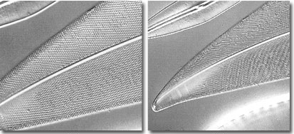
Aliasing
Nyquist sampled
Undersampled

Slide 32
A resolution-centric view of imaging
The objective NA sets the highest resolution you can measure (1.4 NA ~ 220 nm)
To achieve this resolution, 220 nm in your image must cover 2 pixels
Choose your magnification to achieve this
For 6.45 μm pixels, we need a total magnification of 6450/110 = 58.6
So for 1.4 NA, a 40x lens would be undersampled, a 60x would be just at the Nyquist limit, and a 100x lens would oversample

Slide 33
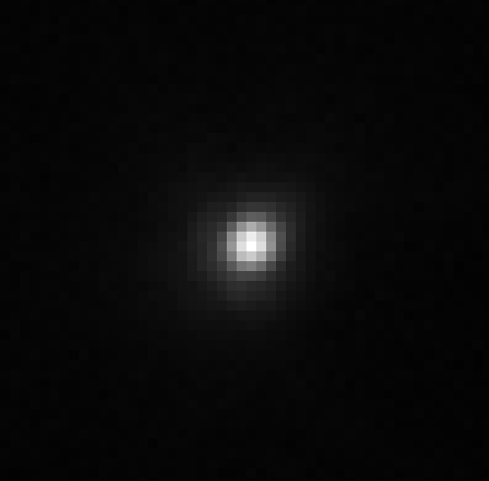
Actual PSF

Slide 34
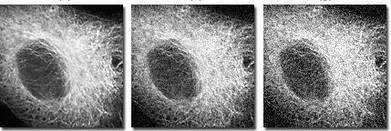
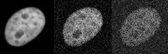
Noise
Longer exposure times are better – why?
Increasing exposure time

Slide 35
Noise
Read noise – inherent in reading out CCD
Scales as the square root of readout speed (faster = noisier)
For CoolSNAP HQ2: 4.5 e⁻ / pixel @ 10MHz (90 ms readout)
5.5 e⁻ / pixel @ 20MHz (180ms readout)
Dark current – thermal accumulation of electrons
Cooling helps, so negligible for most applications
CoolSNAP HQ2: 0.001 e⁻ / pixel / s (@ -30°C)

Slide 36
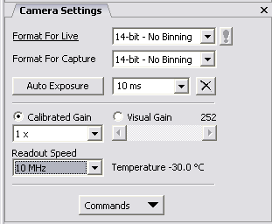
Noise
Photon Shot Noise: Due to the fact that photons are particles and collected in integer numbers
Square root of the number of photons
1 photon ≠ 1 count in your image – depends on the camera (A/D) gain
Zero photons collected doesn’t result in zero being measured on the camera – it has an offset

Slide 37
Signal/Noise Ratio (SNR)
Signal = # of photons
Noise = √ (read noise² +(# of photons))
At low photon numbers, read noise dominates
At high photon numbers, SNR = (# of photons)/ √(# of photons) = √(# of photons)
So, to double your SNR, you need to acquire four times as long (or 2x2 bin)

Slide 38
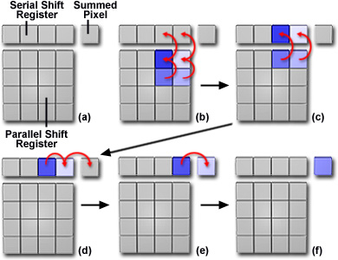
Binning
Read out 4 pixels as one
Increases SNR by 2x
Decreases read time by 2 or 4x
Decreases resolution by 2x

Slide 39
Signal/Noise Ratio (SNR)
Read noise dominates whenever read noise² = # of photons
8 e- read noise → 64 photons
16 e- read noise → 256 photons
50 e- read noise → 2500 photons
Full range on Coolsnap HQ2 with 4x gain: 4095 photons

Slide 40
What does this look like?
1000 photons / pixel on average; ~5000 in brightest areas
Test image
no read noise
5 e⁻ read noise
Photon shot noise ~ 6x read noise

Slide 41
What does this look like?
100 photons / pixel on average; ~500 in brightest areas
Test image
no read noise
5 e⁻ read noise
Photon shot noise = 2x read noise

Slide 42
What does this look like?
25 photons / pixel on average; ~125 in brightest areas
Test image
no read noise
5 e⁻ read noise
Photon shot noise = read noise

Slide 43
What does this look like?
10 photons / pixel on average; ~50 in brightest areas
Test image
no read noise
5 e⁻ read noise
Photon shot noise ~ 2/3 read noise

Slide 44
What does this look like?
1 photon / pixel on average; ~5 in brightest areas
Test image
no read noise
5 e⁻ read noise
Photon shot noise ~ 1/5 read noise

Slide 45
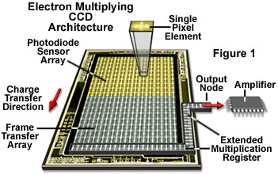
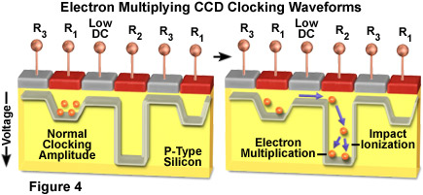
Beating the read-out noise EMCCD

Slide 46
EMCCD result
Fast noisy CCD – runs at 30 fps, but 50 e⁻ read noise
Multiply signal by 100-fold – now read noise looks like 0.5 e⁻
Downside – multiplication process adds additional Poisson noise, so your QE looks like it’s halved
Upside – you get to image fast without worrying about read noise

Slide 47
Hypothetical CCD/EMCCD comparison
100 photon / pixel on average; ~500 in brightest areas
Slow scan CCD
4e⁻ read noise
(1 sec read time)
Video rate CCD,
50e⁻ read noise
Video rate EMCCD
50e⁻ read noise
200x gain

Slide 48
How many intensity levels can you distinguish?
Full well capacity (16 000 e⁻)
Readout noise: 5e-
Dynamic range:
FWC/readout noise: 3200
0.9 * FWC / (3 * readout noise) = 960
(Human eye ~ 100)

Slide 49
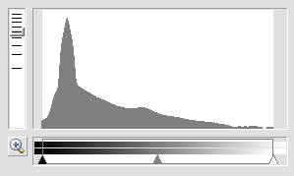
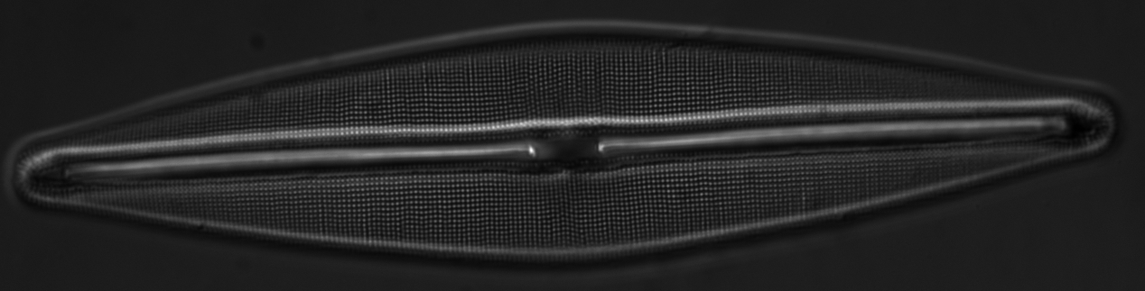
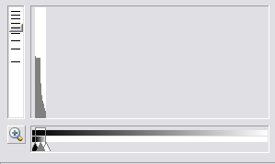
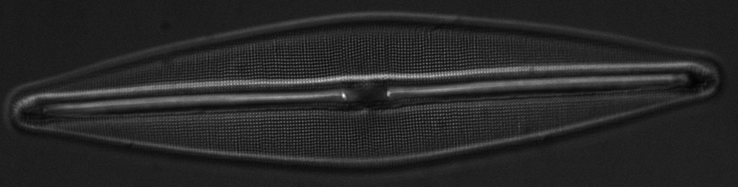
Check your histogram
# of
pixels
Intensity

Slide 50
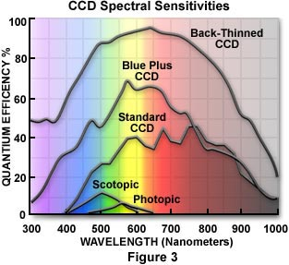
Quantum Efficiencies

Slide 51
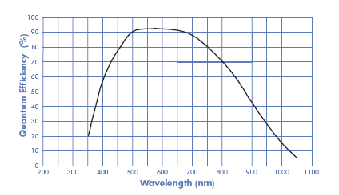
Quantum efficiency
HQ2
Cascade II

Slide 52
Forthcoming technology: sCMOS
From Andor / Fairchild / PCO
Claims:
5.5 Megapixel sensor
< 2 e⁻ read noise
60% QE
30 – 100 frame / sec readout

Slide 53
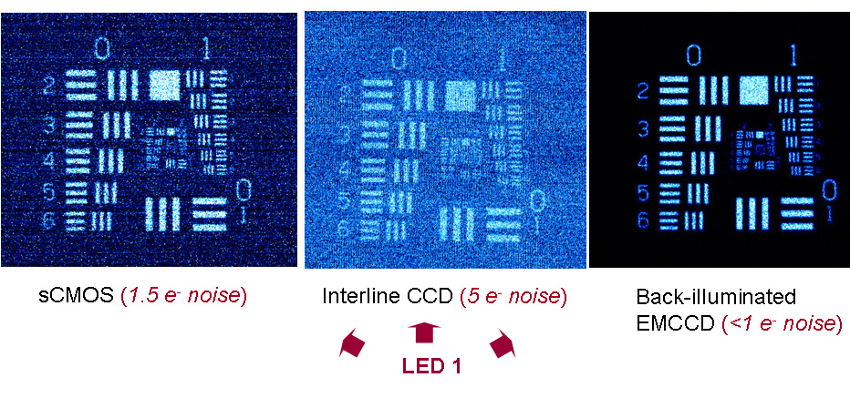
Forthcoming technology: sCMOS
www.scmos.com

Slide 54
Improve Signal/noise
Use bright, non-bleaching fluorophores
Best possible optics (high NA lenses, high QE camera, high transmission filters, reduce spherical aberration, no phase!)
Minimize optical elements between your sample and the camera (use bottom port!)
Work in the dark, use clean cover slips, reagents, etc..
Increase exposure or use frame averaging
Binning (at the expense of spatial resolution)

Slide 55
More reading
www.microscopyu.com
James Pawley, Ed. “Handbook of Biological Confocal Microscopy, 3rd ed.), especially appendix 3: “More than you ever really wanted to know about charge-coupled devices”
James Janesick, “Scientific Charge Coupled Devices” (if you really, really, want to know about CCDs)
Acknowledgements
Nico Stuurman, Mike Davidson

